Slide 1
A Debate on Privacy
Phone companies should be required to unlock the phones of criminals/terrorists.
Leo Wang & Raymond Phan

Slide 2
Topics
Public Safety vs. Personal Privacy
Consequences of Implementation
Summary

Slide 3
Topic 1
How do you balance the conflicting interests of national security and personal privacy on the issue of encryption?
Public Safety vs. Personal Privacy
Notes:
First topic is the main point of presenting this debate. The two sides we have need to choose to lean towards the interests of either national security or personal privacy on the topic of encryption.

Slide 4

Going Dark Problem
Originally a military time for sudden termination of communication
Describes digital communication which cannot be tapped because of modern encryption
It takes immense resources to bypass any instance of modern encryption
This is a roadblock for the legal right for law enforcement to monitor communications for public safety
(Comey, James B.)
Notes:
The problem presented is classically called the going dark problem. This problem has arised in the modern era of technology because of how strong and fast encryption has developed recently.
Before most communications happened through encrypted networks, law enforcement had many options to obtain private information for the sake of investigation. Examples could be wiretapping phones, phone companies have logs of user conversations, and such. In many countries, including Canada there exists laws which allow law enforcement to monitor private communications like calls and text messages with a warrant, and sometimes even without a warrant in cases of emergencies like national security or cases where the possibility of harm to individuals exists.

Slide 5
For
Companies should prioritize national security
Notes:
I will go over some examples where companies have or could have assisted in criminal cases to showcase that they have the capability to support law enforcement agencies in their investigations.

Slide 6
For - Example
Context
Example
Conclusion
iPhone confiscated from 2015’s San Bernardino shooter
FBI needed to access the encrypted contents for investigation
FBI asked Apple to “backdoor” the phone
US issued court order sided with FBI
Suggested solution had Apple open the device on site and give the contents
A backdoor is dangerous, but precautionary measures existed
FBI hacked the device independent of Apple in the end
14 lives lost
Notes:
Only after exhausting other options did the FBI go to apple to install a vulnerable OS to try and access the contents
Suggestion for the development and usage of the “backdoor” was to happen on Apple premises, after the FBI hacked the contents, Apple could destroy the malware on site.
Despite this Apple refused the offer based on their principles of “not undermining the security of their products”

Slide 7
For - Civil Responsibility
Law enforcement has responsibility to investigate to their best ability
End to end encryption actively hinders their duty
Possible Solutions
Limit the usage of strong encryption
Give authorities to the power to access to protected data upon request
Have service providers assist in getting protected data
Give authorities a master key access for investigative purposes
(Walden, Ian)

Slide 8

For - Backdoor Risk Mitigation
What is it?
Vendor implements a secret access to encrypted information
Allows law enforcement to hack into computers
A possible criteria of a law is to require judicial approval (similar to a search warrant)
Ideally:
If a backdoor exists, it needs restrictive access
Any saved information must be related to the case which the investigation was approved
An approval requires a reasonable suspicion that the data will help the investigation
Notes:
Backdoors are generally seem as unsafe, but in theory we could have a legislation restrict when data can be accessed and the nature of data which is allowed to be recorded or remembered.

Slide 9
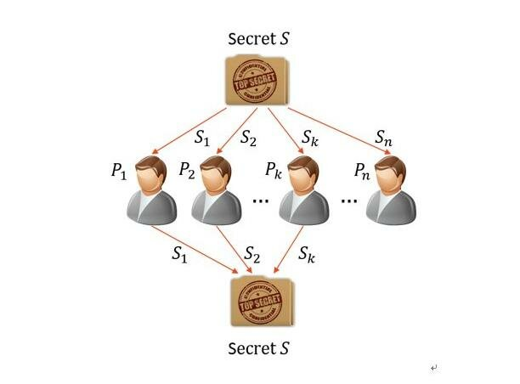
For - Backdoor Risk Mitigation Cont’d
Master key (NSA proposed):
Split in 2, half owned by the vendor, half owned by law enforcement
Permits lawful access as it requires the vendors permission
Enables transparency between the law and vendors
Limitations/Cons:
2 points of failure
Prohibitively complex to implement
(Owen, Robyn)
Notes:
Backdoors are pretty frowned upon, especially by the technically adept. There have been proposals for vendors to implement a split key type of system which uses two secret keys.

Slide 10
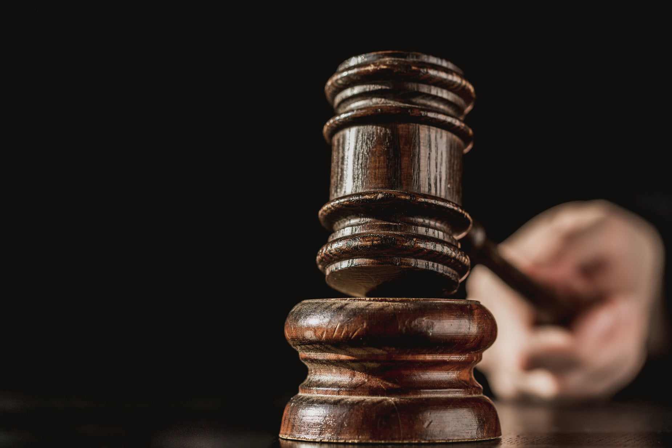
For - Lawful Hacking
More often used in practice (ex. Many tech giants support bug bounties)
For investigations, this needs legal approval since the medium being hacked is a personal device
Exploits vulnerabilities to hack into the device the traditional route
Exactly the same process as a bad actor would need to take
Current no statute for allows for this
(S. M. Bellovin)

Slide 11
For - Company Data Collection
Prioritizing public safety is feasible & beneficial
All tech giants collect and use user data for profit
NONE of the benefit of this data is given back to users
The technology for obtaining useful investigative data definitely exists
Countries can effectively collaborate on critical cases
Limitations & Issues
State organizations like the FBI and CIA have been known to abuse power
Hundreds of thousands of data requests have been disclosed since 2013 according to Apple’s transparency report

Slide 12
Against
Companies should prioritize personal privacy

Slide 13
A Violation of Constitutional Rights
Fourth Amendment
Protects citizens from unreasonable search and seizure
Search warrant can authorize the unlocking of a smartphone secured by biometric authentication methods
No authorization for passcode authentication methods!
Protected under the Fourth Amendment
Fifth Amendment
Not be subject to criminal prosecution and punishment without due process. Citizens are protected from self-incrimination
Compelling a person to unlock a smartphone via biometrics does not implicate the Fifth Amendment
However, compelling a person to provide a passcode is an
implication of the Fifth Amendment
(Cole, 2018)

Slide 14
Privacy Rights and a Dangerous Precedent
Unlocking the smart phones of individuals
Privacy is a fundamental right
Demanding access to personal information for other reasons
Undermines privacy rights
Sets a dangerous precedent for the future
Are smartphones the first step?
A lot of information now are stored on phones
Geolocations, IDs, Banking Info, etc.
Your information is no longer privy due to smartphone access

Slide 15
Topics
Public Safety vs. Personal Privacy
Consequences of Implementation
Summary

Slide 16
Topic 2
What are the possible costs and benefits to forcing companies to comply to these information requests?
Consequences of Implementation

Slide 17
For
Benefits of forcing compliance
Notes:
I will go over some examples where companies have or could have assisted in criminal cases to showcase that they have the capability to support law enforcement agencies in their investigations.

Slide 18
For - Example 1
Context
Example
Conclusion
Russian annexation of Crimea in 2014
International tensions because of allegations of Russia deploying troops into Ukraine
A Russian soldier posted images online
Some digital photos have geotag metadata
Showed his deployment from Russia to Ukraine
Some data can be attributed with seemingly unrelated things
Cooperation with the platform this data is stored is very valuable
(Li, David K)
Notes:
Alexander Sotkin, a sergeant in the Russian Army had posted multiple images to his public instagram page showing his deployment from Russia to Eastern Ukraine

Slide 19
For - Example 2
Context
Example
Conclusion
Canadian Court Case named dubbed Spencer
Anonymous user sharing illicit media of children through Limeware
Limeware showed the IP Address of users, giving general location info
Law enforcement requested the ISP associated for more info
Accused appealed to privacy rights
Accused could not be caught without help of provider company
Privacy is preserved on the network
User info only exposed the case of lawful inspection
(Chan, Gerald, and Stephen Aylward)
Notes:
Privacy rights: Canadian Charter Section 8, stating violation to privacy rights and thus the search was inadmissible.
The Supreme court held that the users IP address is publically broadcast on a network to be an active member. Just because this is public does not mean the user is not anonymous. Similar to how going out in public, even though you yourself are exposed with the public to interact, you still retain anonymity and privacy interests are held.

Slide 20
For - Idealistic Assumptions
To prevent abuse
Jurisdictions should make choices which benefit the citizens
A court order to break into a personal electronic device should we backed by reasonable evidence or motivation
Therefore such choices should benefit the greater society
Data taken for investigative purposes can only be related to the case
Companies who comply to these orders may remain anonymous
(Sagan, Aleksandra)

Slide 21
For - Theoretical Benefits
More Solved Cases: Many unsolved are because of inaccessible data
Faster Investigation: Some investigations are very time sensitive, the faster the law can acquire information, the higher chance the case can be solved
Public Safety: Citizens can rest assured that less bad actors can freely roam the encrypted space online with little to no risk
Minimized Privacy Risk: The general public's encryption should still be secure
(Baig, Edward C)

Slide 22
Against
Costs of forcing compliance

Slide 23
Against - Significant Costs to Companies
Forcing Compliance - Financial & Prospective Costs
Building backdoors into technologies would impose significant costs to companies
Stunt future innovation in the privacy industry
Naive to expect individuals to continue using technologies that have backdoors
Could result in a downward trend in sales
Market volatility, unpredictable outcome
Loss of sales from people valuing privacy
(Walsh et al., 2019)

Slide 24
Against - Backdoors are a Risk to the Public
Forcing Compliance - Exploitable Backdoors
Technologies that comply with backdoor requirements have turned out to be less secure
Backdoors act as another “point” of weakness that hackers are able to exploit
Put the public at a greater risk of having their data stolen
(Abelson et al., 2015)

Slide 25
Backdoors are a Risk to the Public - Cont’d
Forcing Compliance - Backdoors have been exploited in the past
New features (backdoor access) come with new vulnerabilities
(Abelson et al., 2015)
Hypothetical: Increased Crime Rates?
No data will be truly private (if exploited)
Fraud
Blackmail
Difficult to keep out of the wrong hands

Slide 26
Summary

Slide 27
For
A system is possible to allow legal access to private information for investigative purposes
Public safety can be improved
Criminal investigations will be much easier because of technology
Statutes must be carefully constructed to prevent abuse of power, but can be aided with technology like split-key encryption

Slide 28
Against
Giving power to search protected data is a privacy violation
Private information is privy to the state at a request’s notice
Backdoors are a vulnerabilities for data breaches
Fraud and corruption is commonplace are common in intelligence agencies
Many search warrants end up with no helpful information
Imposes hefty financial costs to companies

Slide 29
References
Lachance, Naomi. “Apple, Google Ordered To Unlock Smartphones Since At Least 2008.” All Tech Considered [BLOG], NPR, 2016. Accessed 1 June 2023.
Baig, Edward C. “Should Apple Help DOJ Unlock Terrorist’s Iphones?” USA Today, 15 Jan. 2020, www.usatoday.com/story/tech/2020/01/15/pensacola-debate-should-apple-help-fbi-crack-shooters-iphones/4464120002/. Accessed 1 June 2023.
S. M. Bellovin, "The Law and Lawful Hacking," in IEEE Security & Privacy, vol. 19, no. 4, pp. 76-76, July-Aug. 2021, doi: 10.1109/MSEC.2021.3077374. Accessed 1 June 2023.
Sagan, Aleksandra. “What Powers Do Police Have for Online Surveillance? | CBC News.” CBC, 28 Mar. 2013, www.cbc.ca/news/canada/what-powers-do-police-have-for-online-surveillance-1.1333667. Accessed 3 June 2023.
Chan, Gerald, and Stephen Aylward. FBI v. Apple and Beyond: Encryption in the Canadian Law of Digital Search and Seizure, www.isrcl.com/wp-content/uploads/2021/05/Aylward-Stephen-FBI-v-Apple-and-Beyond-Encryption-in-the-Canadian-law-of-digital-search-and-seizure.pdf. Accessed 5 June 2023.
Comey, James B. “Going Dark: Are Technology, Privacy, and Public Safety on a Collision Course?” FBI, 16 Oct. 2014, www.fbi.gov/news/speeches/going-dark-are-technology-privacy-and-public-safety-on-a-collision-course. Accessed 5 June 2023.
Owen, Robyn. “Law Enforcement’s Dilemma: Fighting 21st Century Encrypted Communications With 20th Century Legislation.” Homeland Security Affairs, 2018. Accessed 5 June 2023.

Slide 30
References
Abelson, H., Anderson, R., Bellovin, S. M., Benaloh, J., Blaze, M., Diffie, W., Gilmore, J., Green, M., Landau, S., Neumann, P. G., Rivest, R. L., Schiller, J. I., Schneier, B., Specter, M., Weitzner, D. J. (2015). Keys Under Doormats: Mandating insecurity by requiring government access to all data and communications. Computer Science and Artificial Intelligence Laboratory, Massachusetts Institute of Technology.
Benner, K. (2020). Barr asks apple to unlock pensacola killer’s phones, setting up clash. The New York Times.
Cole, R. (2018). The constitutional insecurity of secured smartphones: unlocking the current fourth and fifth amendment safeguards protecting secured smartphones from law enforcement searches. University of La Verne Law Review, 39(2), 173-223.
Fakhoury, H., & Kayyali, D. (2014, October). Know Your Rights. Electronic Frontier Foundation. https://www.eff.org/issues/know-your-rights
Walsh, J. J., Combs, E., & Banaszynski, D. (2019). International Pressure Grows for Companies to Create "Backdoors" to Encryption. Intellectual Property & Technology Law Journal, 31(1), 7-9.
Li, David K. “Russian Soldier Alexander Sotkin Posts Instagram Selfies That May Link ...” Naws.Come.Au, 1 Aug. 2014, www.news.com.au/technology/online/russian-soldier-alexander-sotkin-posts-instagram-selfies-that-may-link-russian-military-to-ukraine/news-story/33159bfb9ee05ee61a661e92456f0f2c.
Walden, Ian. “‘The Sky Is Falling!’ – Responses to the ‘Going Dark’ Problem.” Computer Law &amp; Security Review, 26 May 2018, www.sciencedirect.com/science/article/abs/pii/S0267364918301973.

